Slide 1
Ecological Ontology:
Niches, Environments, Contexts

Slide 2
Formal Ontology
atomism vs. holism
set theory
mereology

Slide 3
Environments a Neglected Major Category in the History of Ontology
Substances
States, Qualities, Powers, Roles …
Processes
-- environments missing from Aristotle, from DOLCE, from entity-relationship models

Slide 4
environment place niche habitat setting hole spatial region interior

Slide 5
Applications of these concepts
in biology, ecology
in anthropology
in law
in politics
in medicine
in embryology

Slide 6
A Theory of Contexts, Settings, Environments for Social Acts
Searle:
X counts as Y in context C
What kinds of entities are social contexts?

Slide 7
The Idea: Contexts can be Nested One Inside Another
Many settings occur in assemblies:
A unit in the middle range of a nesting structure is simultaneously both circumjacent and interjacent,
both whole and part, both entity and environment. (Roger Barker)

Slide 8
Human body
Compare the hierarchical organization of the human body into organs, cells, …
modular organization – with many things which can go wrong

Slide 9
Large-scale social organizations
are organized as rigidly hierarchical, modular nesting structures, with many things which can go wrong

Slide 10
Ecological Niche Concepts
niche as particular place or subdivision of an environment that an organism or population occupies (TOKEN)
vs.
niche as function of an organism or population within an ecological community (TYPE)

Slide 11
Elton
the ‘niche’ of an animal means
its place in the biotic environment, its relations to food and enemies. [...]
When an ecologist says ‘there goes a badger’ he should include in his thoughts some definite idea of the animal’s place in the community to which it belongs,
just as if he had said ‘there goes the vicar’ (Elton 1927, pp. 63f.)

Slide 12
The Niche as Hypervolume
foliage density
humidity
temperature

Slide 13
The Niche as Hypervolume
foliage density
humidity
temperature

Slide 14
The Niche as Hypervolume
foliage density
humidity
temperature

Slide 15
The Niche as Hypervolume
foliage density
humidity
temperature

Slide 16
Hypervolume niche is a location in an attribute space
defined by a specific constellation of environmental variables such as degree of slope, exposure to sunlight, soil fertility, foliage density...
… John found his niche as a mid-level accounts manager in a small-town bank …

Slide 17
But every hypervolume niche must be realized in some specific spatial location
Niche type must be tokenized in space
or better: it must be tokenized in space-time

Slide 18
Niche Construction
Lewontin: niches normally arise in symbiosis with the activities of organisms or groups of organisms;
they are not already there, like vacant rooms in a gigantic evolutionary hotel, awaiting organisms who would evolve into them.
“ecosystem engineering”
maintenance of niches (screwdrivers, paintings)

Slide 19

Armchair Ontology

Slide 20
Positive and negative parts
negative
part
or hole
(not made
of matter)
positive
part
(made of matter)

Slide 21
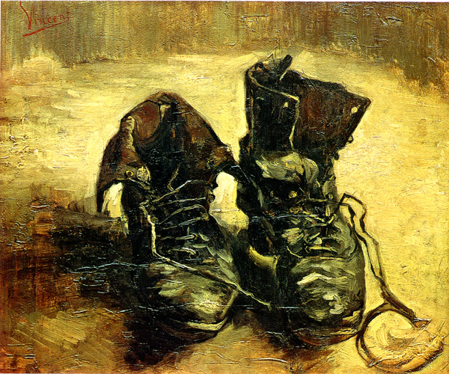
Artifacts and Holes

Slide 22
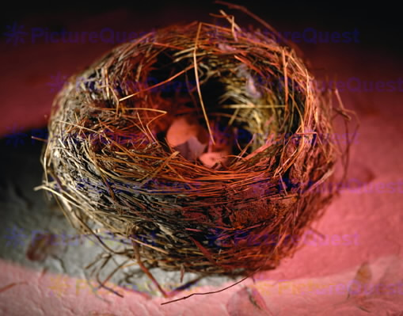
niches, environments are holes

Slide 23
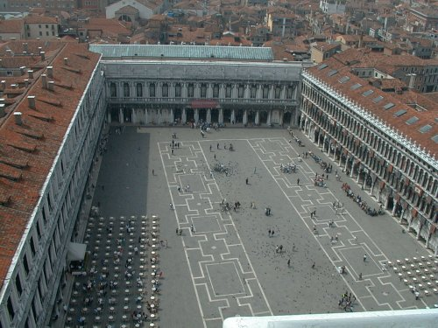
Places are holes
Notes:
Rome, Piazza Navona

Slide 24
Armchair Ontology
artefacts and niches
the niche-tenant relation
vacant niches

Slide 25
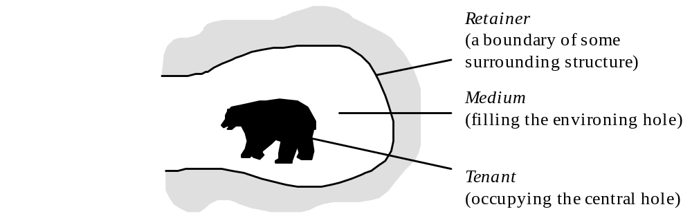
Double Hole Structure

Slide 26
The Structure of Niches
media and retainers
the medium of the bear’s niche is a
circumscribed body of air

Slide 27
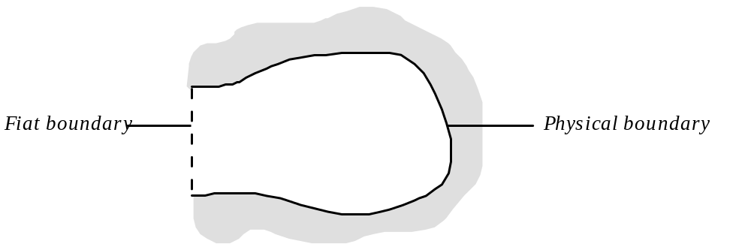
Two Types of Boundary

Slide 28
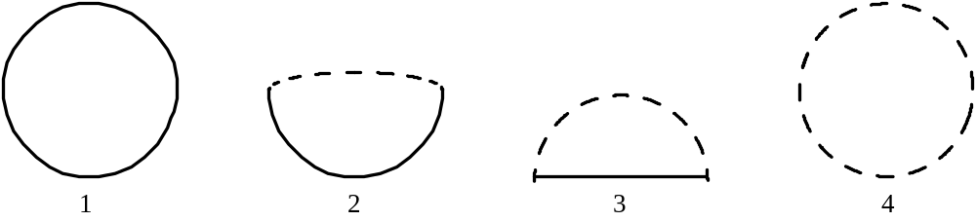
Four Basic Niche Types
1: a womb;
2: a snail’s shell;
3: the niche of a pasturing cow;
4: the niche around a buzzard

Slide 29
Types of Niches
a pond, a nest, a cave, a hut, an air-conditioned apartment building
the history of evolution as a history of the development of niches

Slide 30
all vacant niches must have a retainer
dependence of niche on tenant(s)
the armchair niche
transforming niches of type 2 into niches of type 1

Slide 31
Four Basic Niche Types
1: a house;
2: a snail’s shell;
3: the niche of a pasturing cow;
4: the earth’s atmosphere

Slide 32
stationary niches
1: your office when the door is closed; 2: a rabbit hole; 3: a seat at Yankee stadium; 4: the Klingon Empire

Slide 33
The Ontology of Niches
Niches are in some ways like the interiors of substances
Two concepts of spaceship:
John is in the spaceship
The embryo is in the uterus
The yoghurt is in the refrigerator
Niches and quasi-niches
Substances and quasi-substances

Slide 34
Two concepts of spaceship
John is in London
John saw London from the air
London ≠ London
IBM ≠ IBM
John admired her car
John was sitting in her car
A is part of B vs. A is in the interior of B as a tenant is in its niche

Slide 35
Two concepts of uterus
Issue of parts of the human body
Cavities
Need for Layered Mereotopology

Slide 36
The Ontology of Niches
Niches are endurants
(SNAP entities)

Slide 37
mobile niches

Slide 38
Four Basic Mobile Niche Types
1: a womb;
2: a snail’s shell;
3: the niche of a pasturing cow;
4: the niche around a buzzard

Slide 39
Recall
Lewontin’s ecological engineering

Slide 40
niches on different (granularity) levels of the food chain
a. at the bottom of the hiearchy is the saprophytic chain, in which micro-organisms live on dead organic matter;
b. above this is the primary relation between animals and the plants they consume;
c. above this is the predator chain, in which animals of one sort eat smaller animals of another sort;
d. crosscutting all of these is the parasite chain, in which a smaller organism consumes part of a larger host organism.

Slide 41
Token Science
selection theory is concerned with phenomena at the level of populations; it is ‘concerned with what properties are selected for and against in a population.
We do not describe single organisms and their physical constituents one by one.’
genotypes vs. genotokens
niche theory and set theory

Slide 42
Fiat Boundaries
fish and bird niches as volumes of space
demarcatory vs. behavioral fiat boundaries
trade-off between security/comfort and freedom of movement

Slide 43
Apertures, Mouths, and Sphincters
security vs. freedom of movement
plants
barnacles and snails
fish and birds
skin or hide

Slide 44
Security vs. Freedom
the mouth of the bear, the threshold of your office
freedom of movement and fiat boundaries (of niches and of organisms)
the alimentary canal: hole or part ?

Slide 45
Double Hole Structure

Slide 46
The Medium for Life
a medium is a medium only relative to a given type of niche
a medium requires either a retainer (in the case of a vacant niche) or a tenant (in the case of an occupied niche)
when a tenant leaves its niche the gap left by the tenant is filled immediately by the surrounding medium
Michelangelo’s David
examples of media: air, smoke, water

Slide 47
Mixed Media
mixed media (including radioactive impurities, as well as as vitamins, amino acids, salts, and sugars)
Scrooge, crowds, plastic balls
every medium is maximal
what does the job of filling out the niche whose medium is made of air or water? Answer: bodies of vacuum

Slide 48
Lexical Semantics
the fruit is in the bowl
the bird is in the nest
the lion is in the cage
the pencil is in the cup
the fish is in the river
the river is in the valley
the water is in the lake
the car is in the garage
the fetus is in the cavity in the uterine lining
the colony of whooping crane is in its breeding grounds

Slide 49
Lexical Semantics
‘She swam across the bay in which the submarine was buried and which supplied oysters for the local population.’

Slide 50
The niche around the sleeping bear
There are relations of spatial overlap which do not imply corresponding relations of mereological overlap.
Niches are bounded not just spatially, and not just via physical material (the walls of the cave), but also via thresholds in quality-continua (for instance, temperature).

Slide 51
Hence:
distinct niches, may occupy the same spatial region.
Hence need for Layered Mereotopology
(The niche of the fly overlaps with the niche of the horse,
but the two are on different layers)

Slide 52
Vagueness
A niche for an entity y may have proper parts that are not niches for y
What of the outer boundaries of niches?
Indoor vs. outdoor niches (fog)

Slide 53
Ecological subjects
A niche for a sum y+z is not ipso facto a niche for each of the summed parts.
y+z = John’s head the head plus the rest of John’s body
Not every entity has its own niche. Those which do are natural units
(Compare Aristotle’s theory of places)

Slide 54
Defining Substance
A substance (body, thing) is a maximally connected tenant, a tenant which is such that no larger connected tenant includes it as a proper part.
You are a substance, but your heart is only a connected tenant within your interior.
A group is a tenant including substances as proper parts.

Slide 55
Extending Mereology
mereology, formalized in terms of the single primitive relation: part of
mereotopology, obtained by adding extra primitive relation boundary for
theory of location, obtained by adding extra primitive relation located at
formal ecology, obtained by adding extra primitive relation niche for

Slide 56
Aim
To define structural properties such as:
open, closed,
connected, compact,
spatial coincidence,
integrity,
aggregate,
boundary

Slide 57
Primitives
mereological predicate:
P(x, y) (read: “x is part of y”)
topological predicate:
B(x, y) (“x is a boundary for y”),
locational predicate:
L(x, y) (“x is located at y”)

Slide 58
Defined Terms
D1 O(x, y)=_{df} ∃z (P(z, x) ∧ P(z, y)) overlap
D2 σxφx =_{df} ιx∀y (O(y, x) ↔ ∃z (φz ∧ O(z, y))) sum
D3 x+y =_{df} σz (P(z, x) ∨ P(z, y)) sum of x and y
D4 x–y =_{df} σz (P(z, x) ∧ ¬O(z, y)) difference
D5 l(x) =_{df} ιx(L(y, x)) location of x

Slide 59
Defined Terms
D6 b(x) =_{df} σz B(z, x) boundary of x
D7 i(x) =_{df} x–b(x) interior of x
D8 c(x) =_{df} x+b(x) closure of x
D9 Cl(x) =_{df} x=c(x) closedness
D10 Rg(x) =_{df} c(x) = c(i(x)) ∧ i(x) = i(c(x)) regularity

Slide 60
Defined Terms
D11 C(x, y) =_{df} O(x, y) ∨ O(c(x), y) ∨ O(x, c(y))
connection
D12 EC(x, y) =_{df} C(x, y) ∧ ¬O(x, y)
external connection
D13 IP(x, y) =_{df} P(x, y) ∧ ∀z(B(z, y) → ¬O(x, z))
interior parthood
D14 Cn(x) =_{df} ∀y∀z (x=y+z → C(y, z))
self-connectedness

Slide 61
Some theorems:
T1 B(x, y)  B(x, –y).
T2 B(x, y)  B(y, z)  B(x, z).
T3 P(x, y)  B(y, z)  B(x, z).

Slide 62
niche predicates
N(x, y), read: “x is a niche for y”.
N(x), read: “x is a niche”. This could be defined in terms of the binary predicate, but only if every niche has a tenant
‘N_{α}(x, y)’ and ‘N_{α}(x)’, where ‘α’ ranges over organism-types.

Slide 63
medium and retainer
M(x, y)
“x is a medium for y”
R(x, y)
“x is a retainer for y”

Slide 64
free niche
D15 N*(x, y) =_{df} N(x, y) ∧ ¬∃zR(z, x) free niche for y
D16 N*(x) =_{df} N(x) ∧ ¬∃zR(z, x)
Every niche is either a free niche, in this sense, or else it has a retainer—
which will imply that it has a solid physical boundary for at least a portion of its exterior surface.

Slide 65
further definitions
D17 t(x) =_{df} ιy N(x, y) tenant of x
D18 r(x) =_{df} σz R(z, x) retainer of x
D19 m(x) =_{df} σz M(z, x) medium of x

Slide 66
The Axioms for N
A1 N(x, y) → ¬O(l(x), l(y)) disjointness
A2 N(x, y) → IP(l(y), l(x+y)) spatial containment
A3 N(x, y) → C(x, y) connection of niche
A4 N(x, y) → Cl(y) closure of tenant
A5 N(x, y) → Cn(x) connectedness of niche
A6 N(x, y) → Rg(y) regularity of tenant
A7 N(x, y) → Rg(x) regularity of niche
A8 N(x, y) ∧ N(x, z) → y = z functionality

Slide 67
Every occupied niche is a niche.
A9 ∃yN(x, y) → N(x)

Slide 68
There are no vacant fiat niches
A10 N*(x) → ∃yN(x, y)
Every fiat niche is a niche for something.

Slide 69
Media and retainers
A11 M(x, y) → N(y)
A12 R(x, y) → N(y)
Media are media of niches
Retainers are retainers of niches.

Slide 70
Parts
A13 M(x, y) ∧ P(z, x) → M(z, y)
A14 R(x, y) ∧ P(z, x) → R(z, y)
The parts of a medium for a given niche are themselves media for that niche and the parts of a retainer are themselves retainers.
A15 N(x) → x = σz(M(z, x) ∨ R(z, x))
Niches have no parts other than media and retainers.

Slide 71
Retainers and boundaries
A16 R(z, x) → B(z, x)
Retainers are boundaries of niches (though not all boundaries of niches are retainers).
A17 N(x) → ∃zM(z, x)
Every niche has a medium (though a niche may lack a retainer).
A18 m(x) = m(y) → x = y
No two niches have the same medium (though we leave it open whether two niches can have the same retainer).

Slide 72
Retainers and tenants
A19 N(x, y) ∧ R(z, x) → ¬C(z, y)
Retainers and tenants are not connected to each other, i.e., they do not share any physical parts or boundaries (for they are in every case separated by a medium.)
A20 M(z, x) ∧ R(w, x) → EC(l(z), l(w))
The location of a retainer is externally connected (i.e., connected without overlap) to the location of the medium.

Slide 73
Axioms
A2' N(x, y) → IP(l(y), l(m(x) + y))
It is the medium of an occupied niche that surrounds the tenant.
A3' N(x, y) → C(m(x), y)
It is the medium of an occupied niche that is connected to the tenant. This actually follows from A3 in view of A19.

Slide 74
Axioms
A5' N(x) → Cn(m(x))
The medium of a niche is self-connected (though it need not be compact, i.e., fill the entire environing hole: consider the bat flying in the bear’s cave).
A7' N(x) → Rg(m(x))
The medium of a niche is regular.

Slide 75
Theorems
T1 N(x) → ∃y(N(x, y) ∨ R(y, x))
Every niche has either a tenant or a retainer. This is a consequence of A10.
T2 M(x, y) → ∃z(N(y, z) ∨ R(z, y))
Every medium requires either a tenant or a retainer. This follows from T1 via A12.

Slide 76
Theorems
T3 M(z, x) → P(z, x)
T4 R(z, x) → P(z, x)
Media and retainers are parts of niches. More generally:
T5 M(x, y) ∧ P(z, x) → P(z, y)
T6 R(x, y) ∧ P(z, x) → P(z, y)
All parts of a medium and all parts of a retainer are parts of the relevant niche.

Slide 77
Theorems
T7 N(x, y) → ¬M(y, x)
T8 N(x, y) → ¬R(y, x)
The tenant of a niche is neither a medium nor a retainer thereof.
T9 M(z, x) ∧ R(w, x) → EC(z, w)
The retainer of a niche is externally connected to the medium.
T10 R(z, x) → B(z, m(x))
Retainers are boundaries of media.

Slide 78
Against multiplication of niches
T11 R(x, y) → ¬N(y – x)
A niche minus (part of) its retainer is not a niche.
This excludes the possibility that the difference between two niches might lie entirely in their retainers, which would result in an undue multiplication of niches with what are putatively the same boundaries.

Slide 79
Open Problems
X1 N(x, y) ∧ N(x', y') → ¬N(x + x', y + y')
Mereological summing of niches is never additive.
cats whose niches come together to form a new, fused niche: the new niche is not just the mereological sum of the two separate niches;
for even assuming that the fiat boundaries of the two niches survive the fusion and continue to exist within the interior of the new niche, they are still not a part of it but are rather extrinsic to it.

Slide 80
Open Problems
X2 M(x, y) ∧ B(z, x) → R(z, y) ∨ B(z, t(x))
The boundaries of a medium are either retainers of the niche or boundaries of the tenant.
This would only be true if ‘B’ were understood as standing for physical boundaries, and only if one assumed that a medium has no holes except for the central holes occupied by the tenants.
(But consider again the bat in the bear’s cave, or a cage floating in the sea through which fish can swim.)

Slide 81
Open Problems
X3 M(x, y) ∧ B(z, x) → EC(z, x)
A medium never contains its own physical boundaries.
X4 B(b(m(x)), x)
Any boundary of the medium of a niche is a boundary of the niche itself.
This is false if we consider that the medium need not fill the environing hole completely. (The bat flying in the cave would not be part of the medium of the bear’s niche, yet the surface of the bat would not be part of the retainer either.)

Slide 82
The Ecological Psychology of J. J. Gibson and Roger Barker

Slide 83
Affordances
“The affordances of the environment are what it offers the animal, what it provides or furnishes, either for good or evil.”
James J. Gibson, The Ecological Approach to Visual Perception

Slide 84
Organisms are tuning forks
They have evolved to resonate automatically and directly to those quality regions in their niche which are relevant for survival
-- perception is a form of automatic resonation
-- cognitive beings resonate to speech acts and to linguistic records
-- cognitive beings resonate deontically

Slide 85
affordances: positive and negative features of the environment:
permissions and prohibitions

Slide 86
Gibson’s theory of surface layout
Niches = systems of barriers, openings, pathways to which organisms are specifically attuned,
Include: temperature gradients, patterns of movement of air or water molecules, electro-chemical signals guiding the movements of micro-organisms
But also: traffic signs, instructions posted on notice boards or displayed on the computer screen

Slide 87
Niches
are in many ways analogous to substances

Slide 88
Marks of (bodily) substance
Rounded-offness
Occupies space
Complete boundary
May have substantial parts (nesting)
May be included in larger substances
Has a life (manifests contrary accidents at different times)

Slide 89
Corresponding Marks of Niches
(i) A niche enjoys a certain natural completeness or rounded-offness,
being neither too small nor too large
—in contrast to the arbitrary undetached parts of environmental settings and to arbitrary heaps or aggregates of environmental settings.

Slide 90
(ii) A niche takes up space,
it occupies a physical-temporal locale,
and is such as to have spatial parts.
Within this physical-temporal locale is a privileged locus—a hole—
into which the tenant or occupant of the setting fits exactly.

Slide 91
(iii) A niche
has an outer boundary:
there are objects which fall clearly within it,
and other objects which fall clearly outside it.
(The boundary itself need not be crisp.)

Slide 92
(iv) A niche
may have actual parts which are also environmental settings
(hierarchical nesting)

Slide 93
(v) A niche
may be a proper part of larger, circumcluding niche.

Slide 94
(vi) A niche has a life
is now warm, now cold
now at peace, now at war ….
now expanding, now contracting

Slide 95
Marks of (bodily) substance
Rounded-offness
Occupies space
Complete boundary
May have substantial parts (nesting)
May be included in larger substances
Has a life; is now warm, now cold

Slide 96




Where are Niches?
Concrete Entity
[Exists in Space and Time]
Entity in 3-D Ontology
[Endure. No Temporal Parts]
Entity in 4-D Ontology
[Perdure. Unfold in Time]
Spatial Region
of Dimension 0,1,2,3
Dependent Entity
Independent Entity
Processual Entity
Spatio-Temporal Region
Dim = T, T+0, T+1, T+2, T+3
Quality (Your Redness, My Tallness)
[Form Quality Regions/Scales]
Substance
[maximally connected causal unity]
Process [Has Unity]
Clinical trial; exercise of role
Quasi-Quality
Prices, Values, Obligations
Aggregate of Substances *
(includes masses of stuff? liquids?)
Aggregate of Processes*
Role, Function, Power
Have realizations (called: Processes)
Fiat Part of Substance *
Nose, Ear, Mountain
Fiat Part of Process*
Quasi-Role/Function/Power
The Functions of the President
Boundary of Substance *
Fiat or Bona Fide or Mixed
Instantaneous Temporal Boundary of Process (= Ingarden’s 'Event’)*
Quasi-Substance
Church, College, Corporation
Quasi-Process
John’s Youth. John’s Life

Slide 97
Where are Places?
Concrete Entity
[Exists in Space and Time]
Entity in 3-D Ontology
[Endure. No Temporal Parts]
Entity in 4-D Ontology
[Perdure. Unfold in Time]
Spatial Region
of Dimension 0,1,2,3
Dependent Entity
Independent Entity
Processual Entity
Spatio-Temporal Region
Dim = T, T+0, T+1, T+2, T+3

Slide 98

Types of Places
Concrete Entity
[Exists in Space and Time]
Entity in 3-D Ontology
[Endure. No Temporal Parts]
Entity in 4-D Ontology
[Perdure. Unfold in Time]
Generalized Spatial Region
of Dimension 0,1,2,3
Dependent Entity
Independent Entity
Processual Entity
Spatio-Temporal Region
Dim = T, T+0, T+1, T+2, T+3
Mobile
Stationary

Slide 99
Ecological Psychology
Gibson: Perception
:: Roger Barker: Society
Barker’s
Ecological Ontology of Social Reality

Slide 100
Barker on Unity of Social Reality
“The conceptual incommensurability of phenomena which is such an obstacle to the unification of the sciences does not appear to trouble nature’s units.
Within the larger units, things and events from conceptually more and more alien sciences are incorporated and regulated.”

Slide 101
Barker on Unity of Social Reality
“As far as our behaviour is concerned, … even the most radical diversity of kinds and categories need not prevent integration”

Slide 102
Roger Barker:
Niche as Behavioral Setting
Niches are recurrent settings which serve as the environments for our everyday activities:
my swimming pool,
your table in the cafeteria,
the 5pm train to Long Island.

Slide 103
Behavior Settings
Each behavior setting is associated with certain standing patterns of behavior.
These standing patterns of behavior present everywhere in the domain of medical treatment
(and correspondingly also in the domain of unstructured patient records)

Slide 104
Settings, for Barker,
are natural units in no way imposed by an investigator.
To laymen they are as objective as rivers and forests
— they are parts of the objective environment that are experienced as directly as rain and sandy beaches are experienced. (Barker 1968, p. 11)

Slide 105
Settings
Each setting has a boundary which separates an organized internal (foreground) pattern from a differing external (background) pattern.

Slide 106
Nesting
Many settings occur in assemblies:
A unit in the middle range of a nesting structure is simultaneously both circumjacent and interjacent,
both whole and part,
both entity and environment.

Slide 107
Unity of Behaviour and Ecological Setting
A physical-behavioural unit is a unit: its parts are unified together, but not through any similarity or community of substance.

Slide 108
The Systematic Mutual Fittingness of Behaviour and Ecological Setting
The behaviour and the physical objects … are intertwined in such a way as to form a pattern that is by no means random: there is a relation of harmonious fit between the standard patterns of behaviour occurring within the unit and the pattern of its physical components.
Compare the way in which the processes in the body are constrained by the hierarchical organization of body, organs, cells …

Slide 109
The Systematic Mutual Fittingness of Behaviour and Ecological Setting
(The seats in the lecture hall face the speaker.
The speaker addresses his remarks out towards the audience.
The boundary of the football field is, leaving aside certain predetermined exceptions, the boundary of the game.)

Slide 110
Non-transposability
This mutual fittingness of behaviour and physical environment extends to the fine, interior structure of behaviour in a way which will imply a radical nontransposability of standing patterns of behaviour from one environment to another.
The physical or historical or ceremonial conditions obtaining in particular settings are in addition as essential for some kinds of behaviour as are persons with the requisite authority, motives and skills.

Slide 111
Power and Authority
There are various forces which help to bring about and to sustain this mutual fittingness and thus to constitute the unity of the physical-behavioural unit through time.
Forces which flow in the direction from setting to behaviour include physical constraints exercised by hedges, walls or corridors or by persons with sticks;
they include social forces manifested in the authority of the teacher, in threats, promises, warnings;

Slide 112
The Unifying Effects of the Physical Environment
they include the physiological effects of climate, the need for food and water; and they include the effects of perceived physiognomic features of the environment
(open spaces seduce children, a businesslike atmosphere encourages businesslike behaviour).

Slide 113
Mutual Fittingness
can be reinforced by learning, and also by a process of selection of the persons involved, whether this be one of self-selection (of children who remain in Sunday school class in light of their ability to conform to the corresponding standing patterns of behaviour), or of externally imposed mental or physical entrance tests.

Slide 114
Behaviour shapes Setting
Influences which flow from behaviour to setting, include all those ways in which a succession of separate and uncoordinated actions can have unintended consequences in the form of new types of actions and new, modified types of settings in the future
(as the passage of many feet causes pathways to form in the hillside).

Slide 115
Settings shape Persons
Each person has many strengths, many intelligences, many social maturities, many speeds, many degrees of liberality and conservativeness, and many moralities, depending in large part on the particular contexts of the person’s behavior.
For example, the same person who displays marked obtusiveness when confronted with a mechanical problem may show impressive skill and adroitness in dealing with social situations.

Slide 116
Aurel Kolnai
a human society
… comprehends the same individual over and over again in line with his various social affiliations …

Slide 117
Daily life
= passage through a succession of physical-behavioural units which
are as much a part of the furniture of reality as are garden-variety continuants and occurrents (such as you and me).
Physical-behavioural units have parts.
And they have consequences:
contracts signed, orders issued, judgments passed, medals awarded.

Slide 118
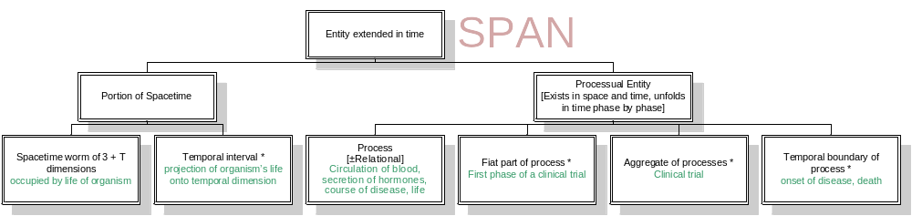
Where are behavior settings?
spatio-
temporal
volumes

Slide 119
4-dimensional environments
Lobsters have evolved into environments marked by cyclical patterns of temperature change
Tudor England
The Afghan winter
The window of opportunity for an invasion of Iraq
The surgical ward during early morning

Slide 120
1
spatio-
temporal
volumes
standardized
patterns of
behavior

